Slide 1


By The PyAuto Team
(Chisom Anaemeribe)

Slide 2

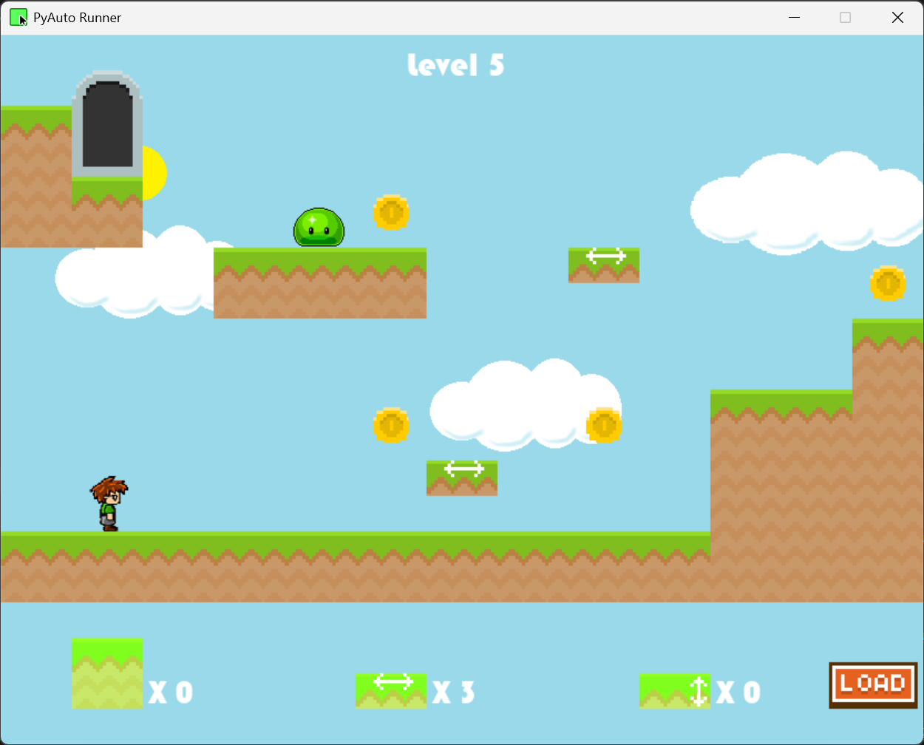
Gameplay
You must go through level courses to complete the game
Before starting, you must place blocks at the right place to go through the course
Your control is limited as you can only jump manually as the character runs automatically

Slide 3
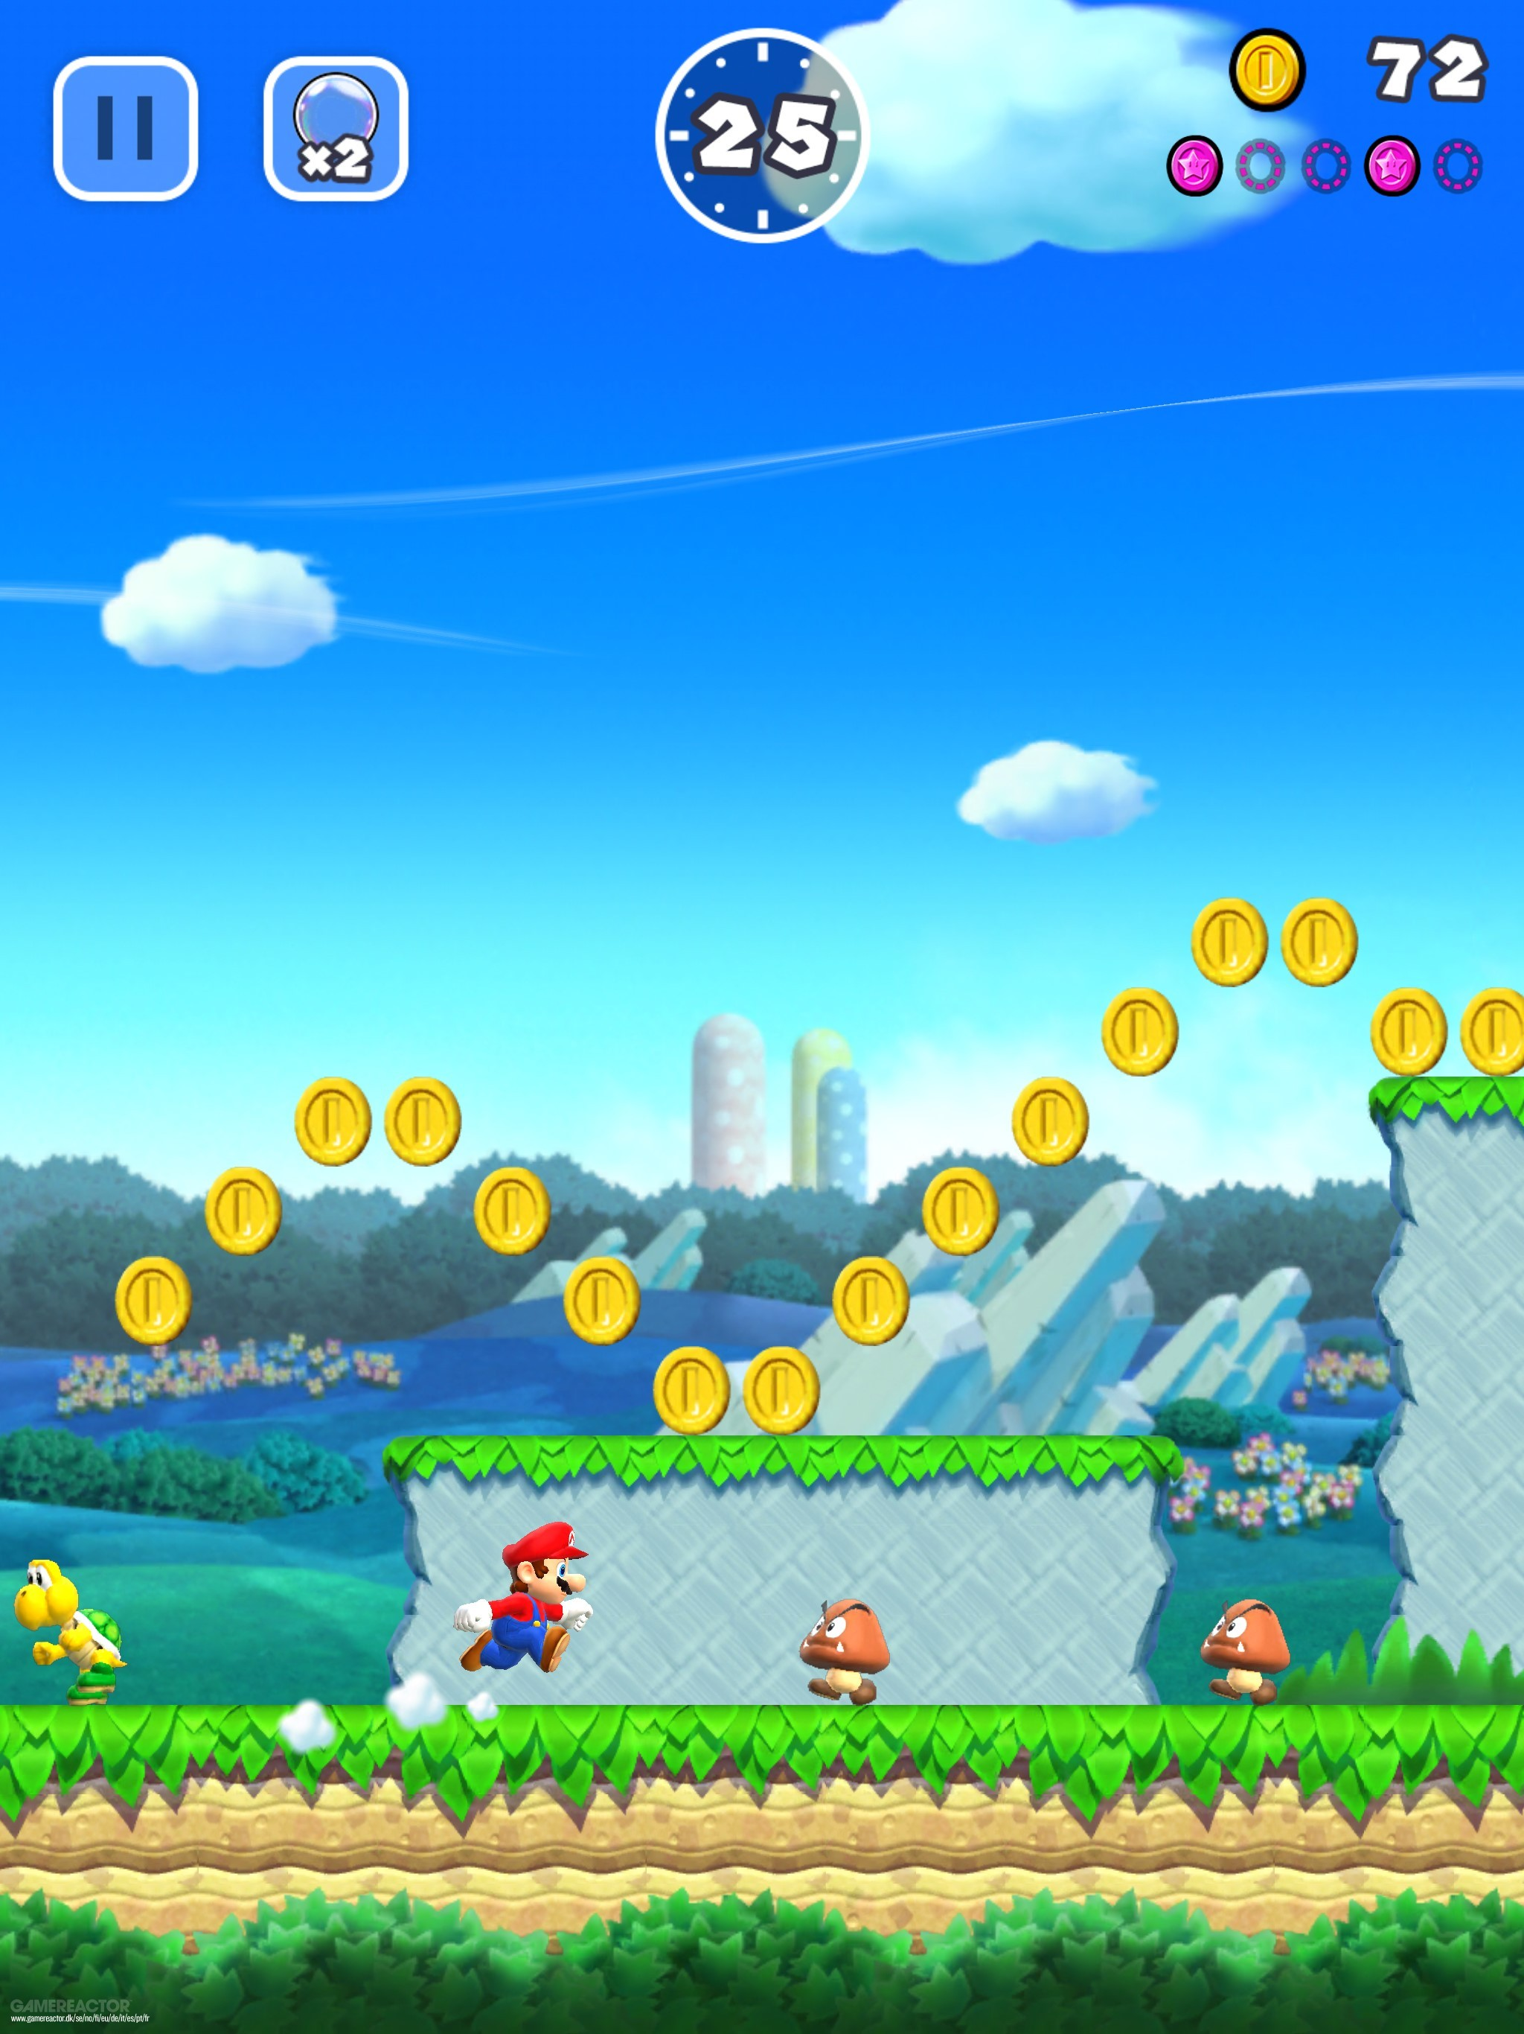
Inspirations
Inspired by:
Super Mario Maker, a game where you place blocks and objects to make your own levels.
Super Mario Run, a game where you automatically run through courses and must time your jumps to complete them.
Wanted to combine these elements into one game that tests the player's strategy and coordination
Must determine where to place the tiles and time their jump movements to complete each level

Slide 4

Development
Developed in Python with the Pygame framework
Used tutorials from Coding with Russ to develop the base platformer engine, including the player, blocks, and obstacles
Added code to determine where block placement is based on the mouse position
Modified the player’s movement code to automatically run and change direction whenever it encounters a wall from a block or platform

Slide 5
Challenges
Develop levels and store their data for the game to use
Found a level editor from Coding with Russ and modified it to work with my game
Developed level concepts to created levels from and play tested them to ensure they can be completed
Package game into a zip file
Wanted easy distribution of my game and let people play my game without installing Python
Found the PyInstaller tool that converted the scripts and data into an executable with a folder containing the game’s data
Created a PowerShell script that used PyInstaller and put the game’s data and executable into a zip file

Slide 6
Reflection
Became more familiarized with Python and the Pygame framework
Learned Python classes, including attributes and methods, data creation, and data processing
Learned how to use graphics and sound effects in Pygame
Learned not to limit myself to my own knowledge and use others work as a baseline for my own creations.

Slide 7
The End

